Slide 1
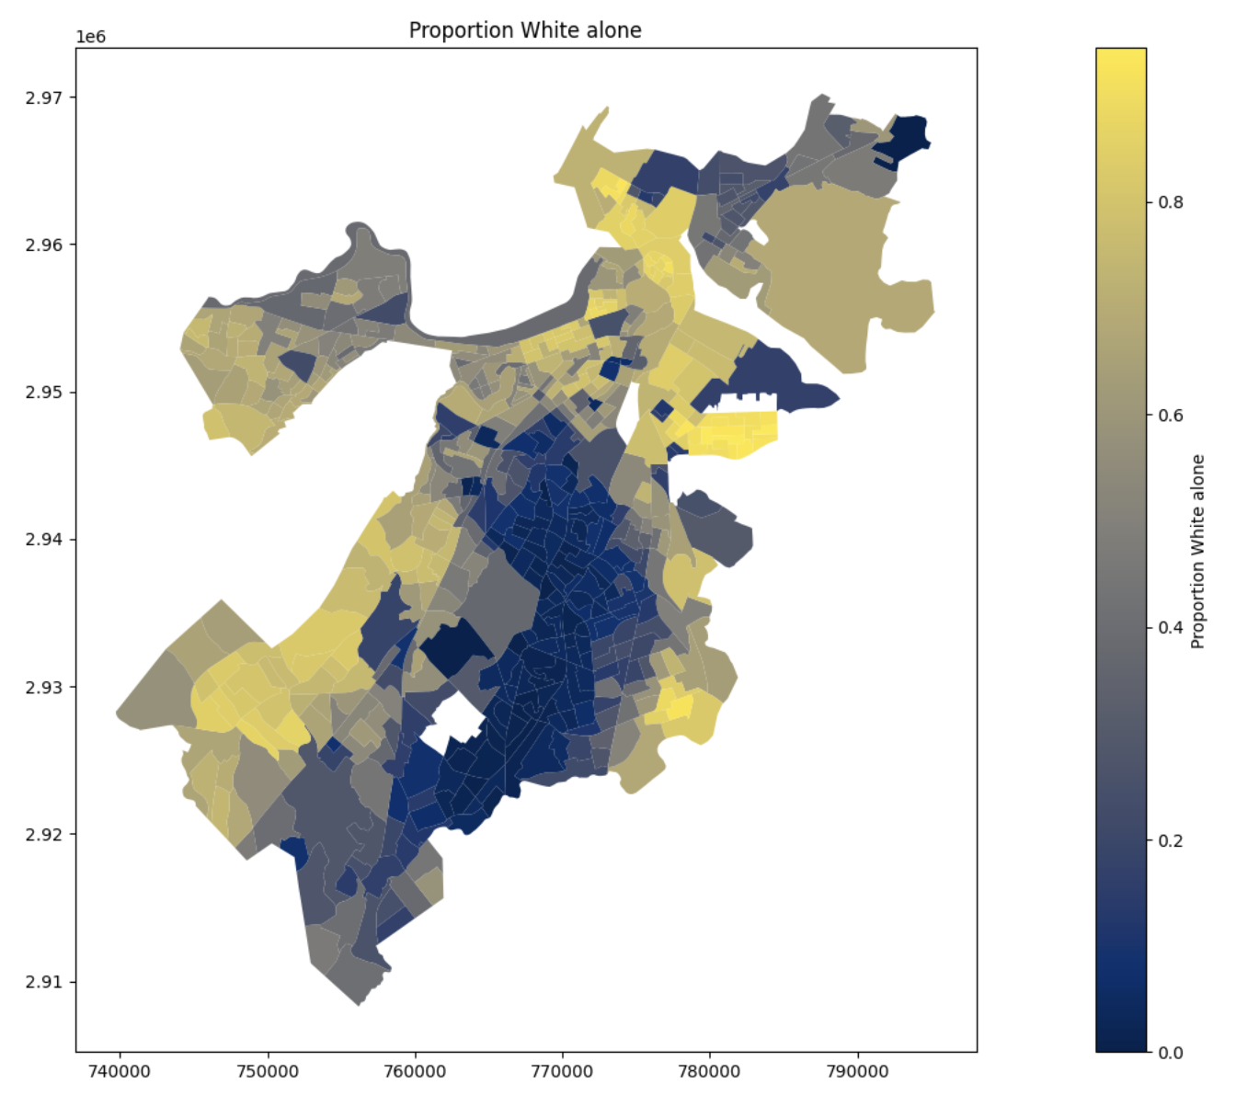
CITY of BOSTON
PERMITTING
Deliverable 2
Boston Permitting Process
CS 506 - Team D Lukas Werk Efim Sokolov
David E. Kim (Team Lead) Richard Hao Jackson Fisk
Analyze approved and rejected permits, including those assessed under Article 80, to uncover insights linked to broader societal, political, and environmental concerns.
Rejected
Appeal
ZBA
Application
Apply and pay underlying fees for the permit
Plan Review & Zoning
City examines the plan for compliance with the zoning laws
Approved
Valid for six months
Notes:
David - Introduction
Lukas - Permitting Process

Slide 2

Meetings
Current Progress
Division of Labor
Datasets
Data cleaning & visualizations
Preliminary Analyses
Census data merging
Geospatial visualizations
Project base questions answered
Basic Exploratory Analyses
Extension project exploration
Fridays 9 AM
Sundays 9:30 PM
D.K. Lead, ZBA, A80, ABP
R.H. Approved Permits
E.S. Census, Income & Geospatial
J.F. Article 80 Permits
L.W. Data Prep. & Cleaning
Approved Permits
Approved Building Permits
Article 80 Permits
Approved Permits subject to Article 80
Zoning Board of Appeal
ZBA decisions
Census Data
For additional analysis
COVID19 Data
Extension Project

Slide 3
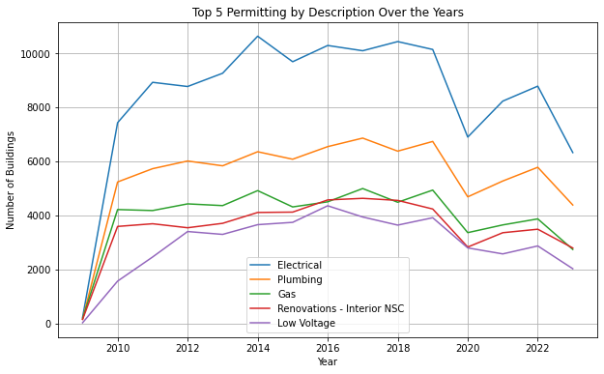
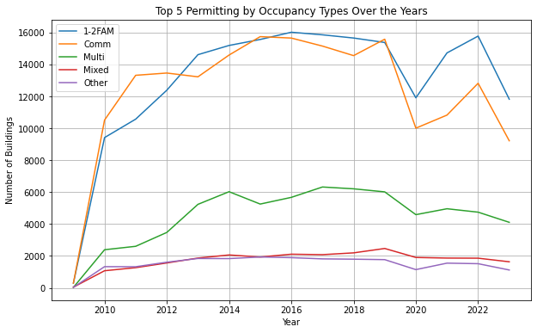
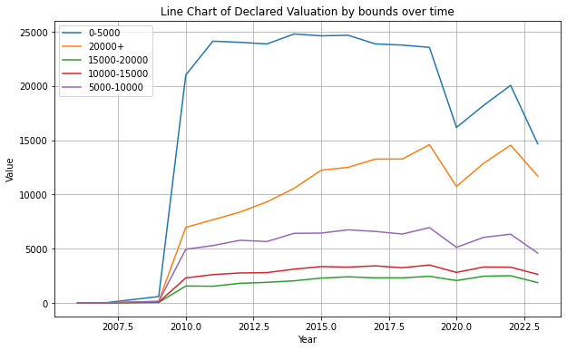
Early Observations - Approved Permits

Slide 4
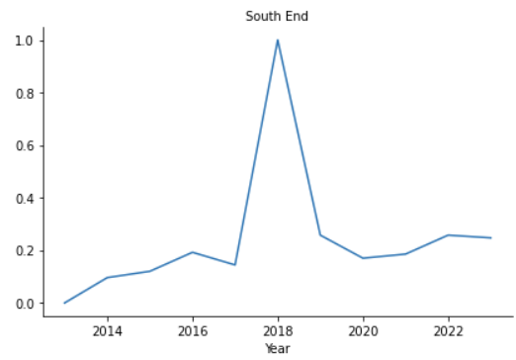
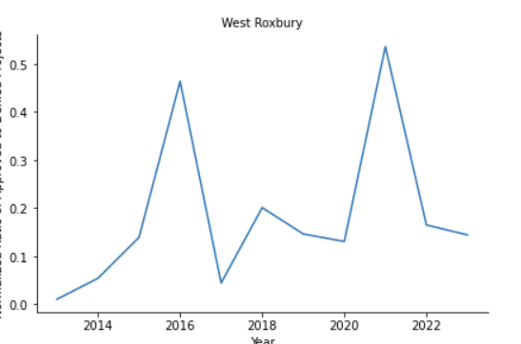
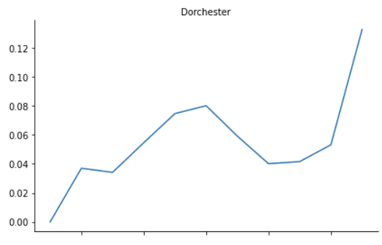
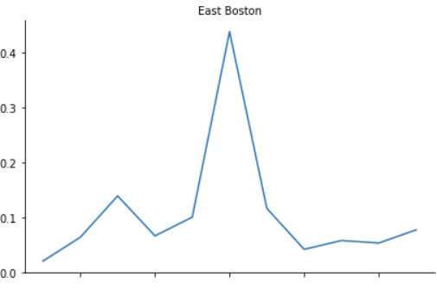
Early Observations - Appeal

Slide 5
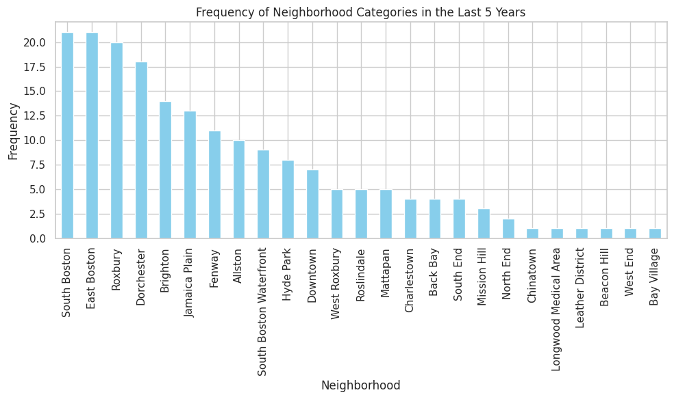
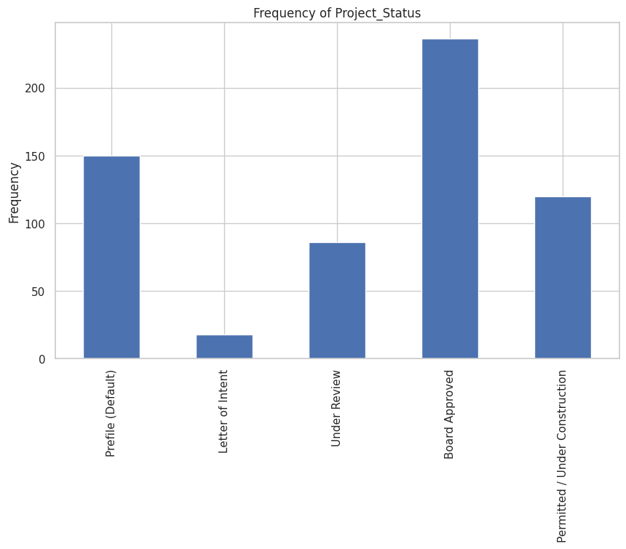
Early Observations - Article 80
Notes:
First: say what first graph is (don’t explain), say Project_status has prefile bottleneck

Slide 6
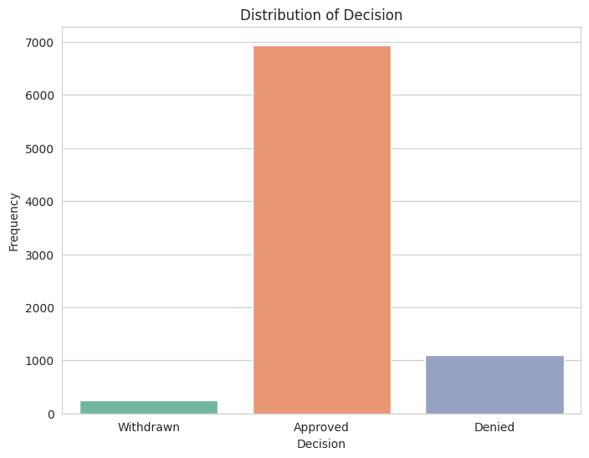
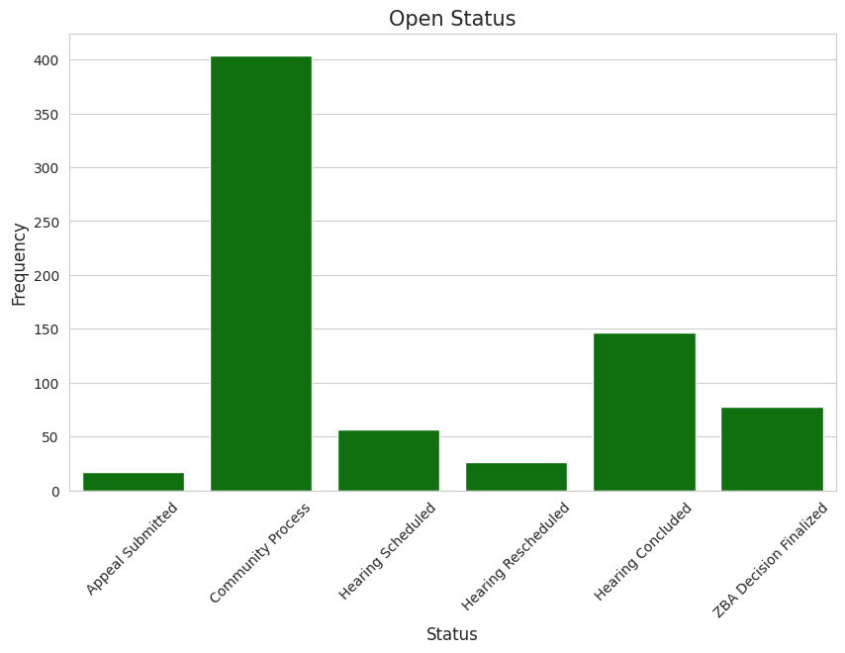
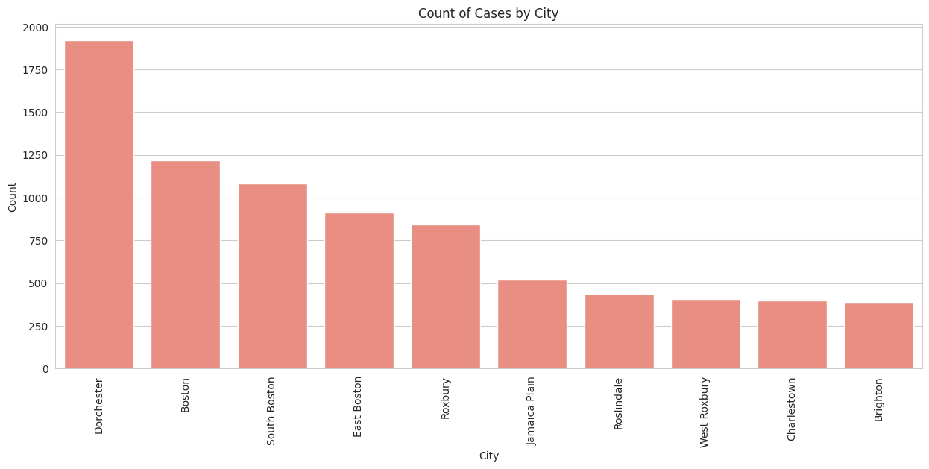
Early Observations - Appealed Permit

Slide 7
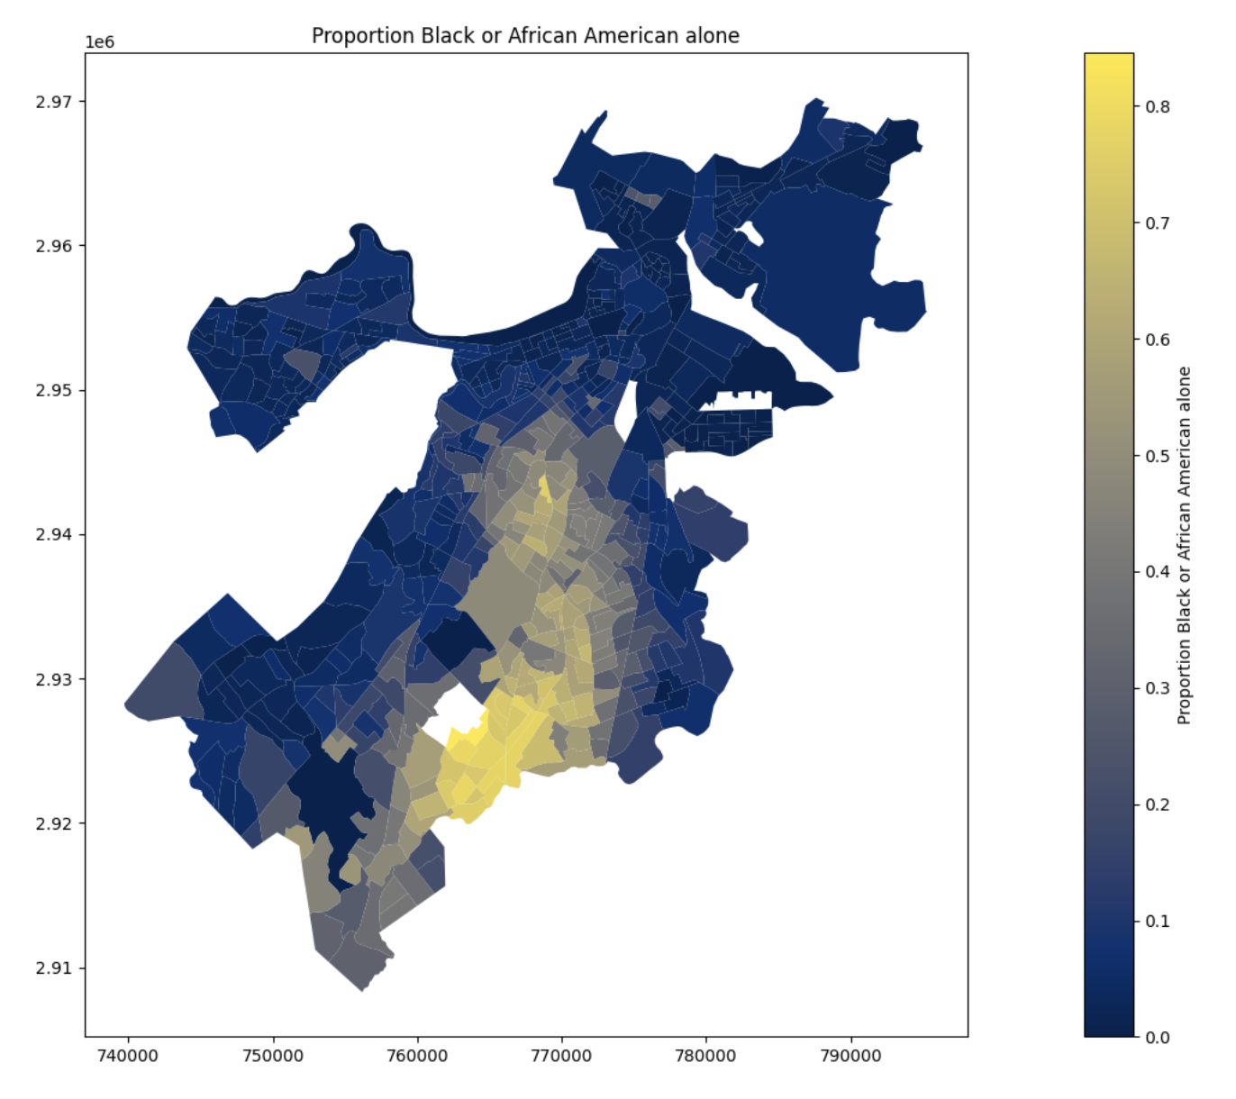
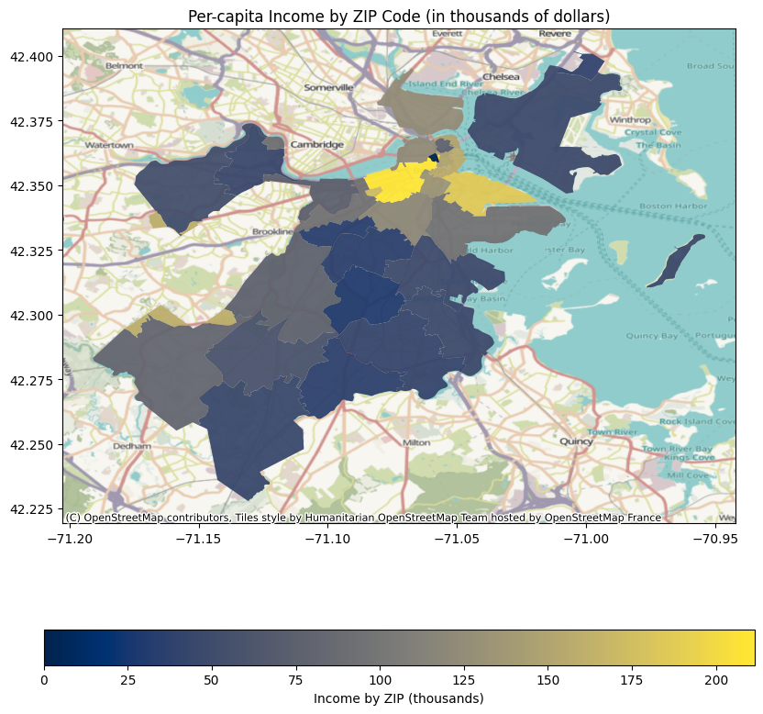
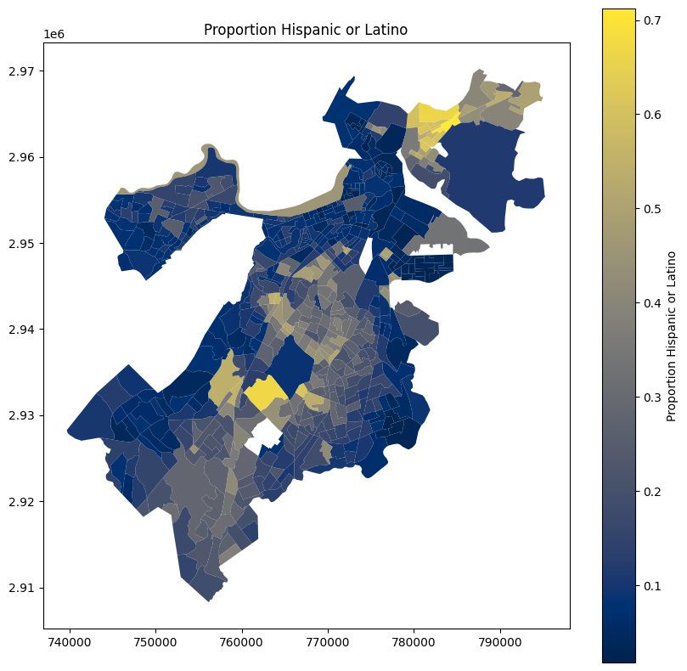
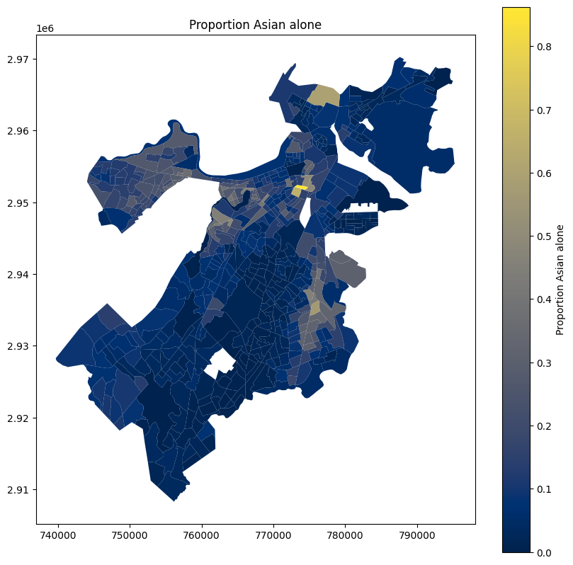
Early Observations - Census

Slide 8
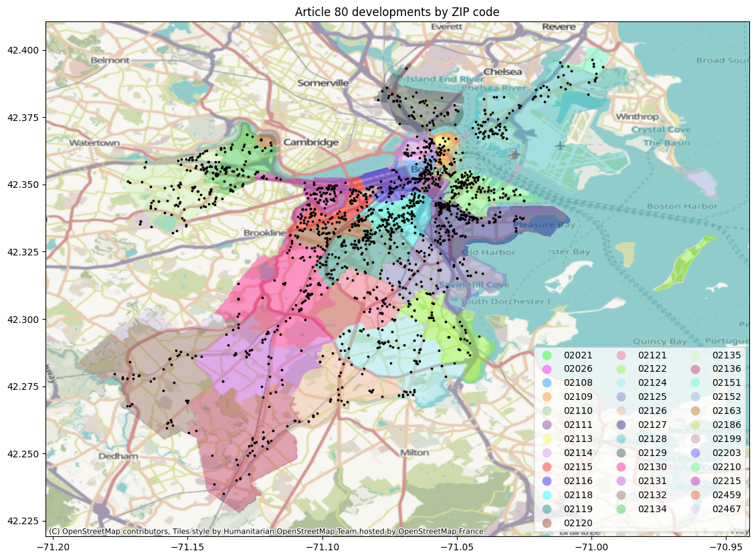
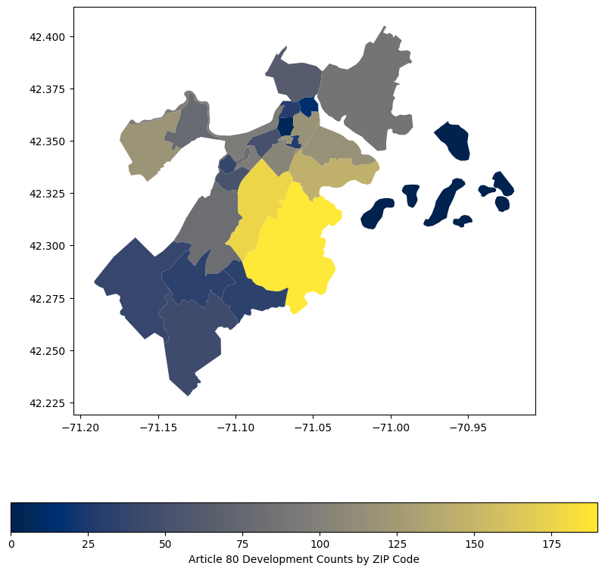
Early Observations - Census

Slide 9
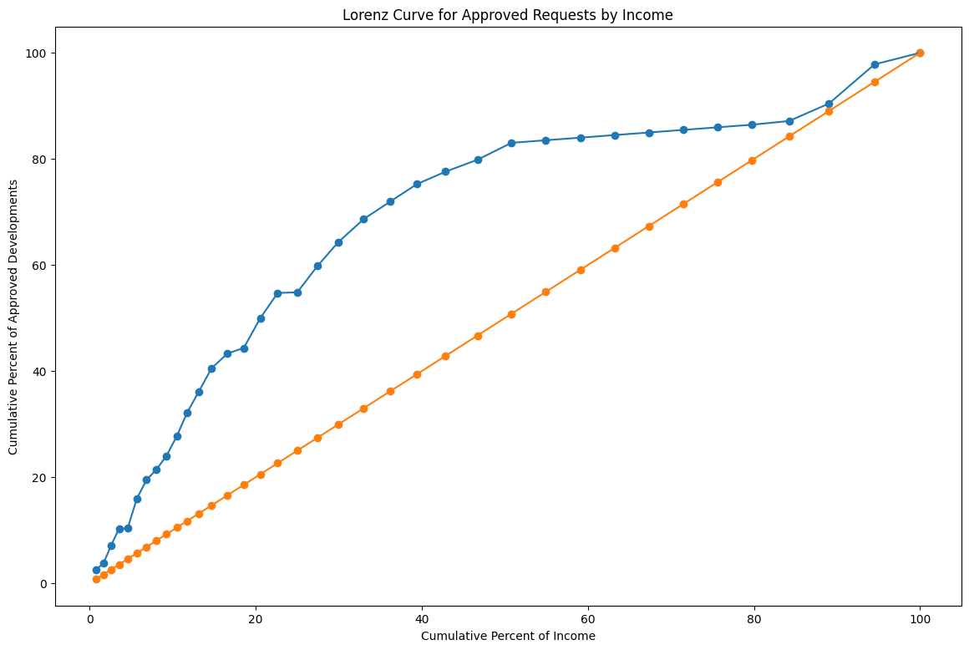
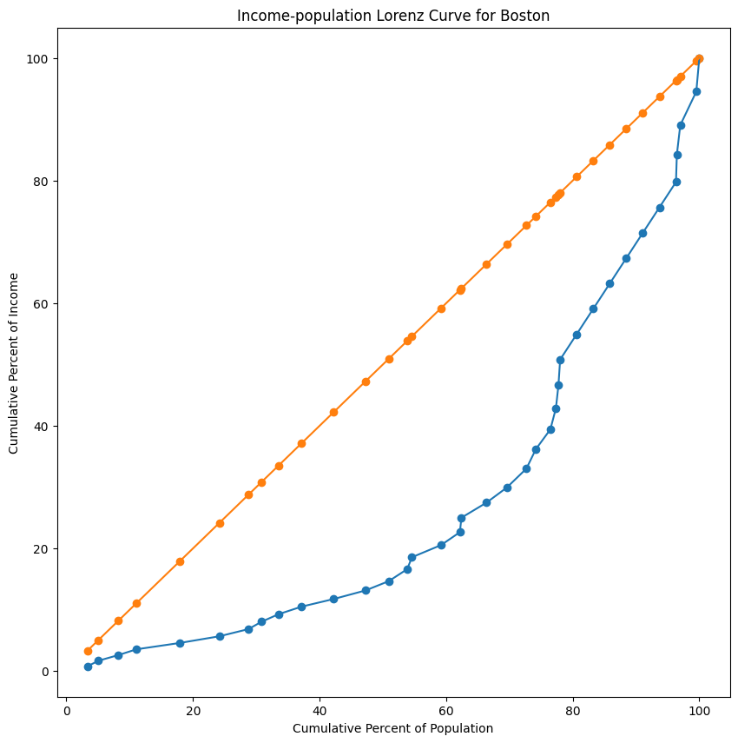
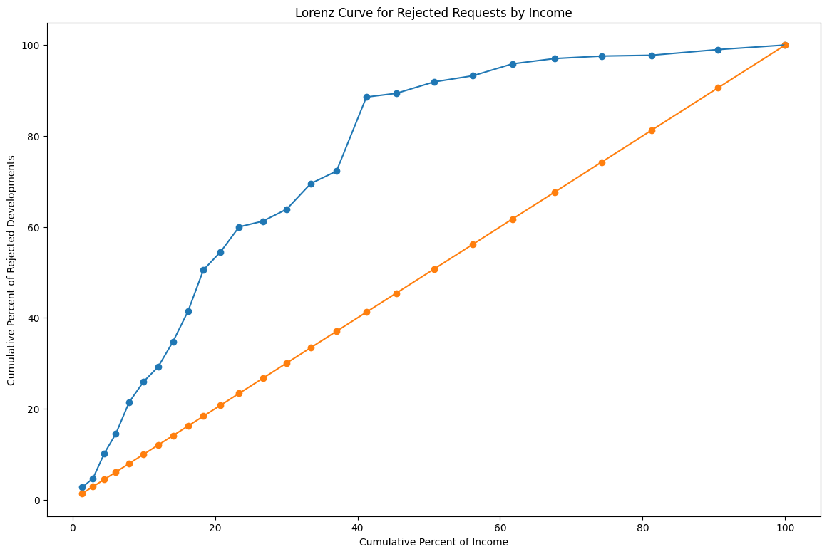
Income Lorenz Curves and Gini Coefficients
Gini Coefficients
Income-Population: 0.48 (US is 0.47)
Income-Development for approved: -0.395
Income-Development for rejected: -0.512

Slide 10
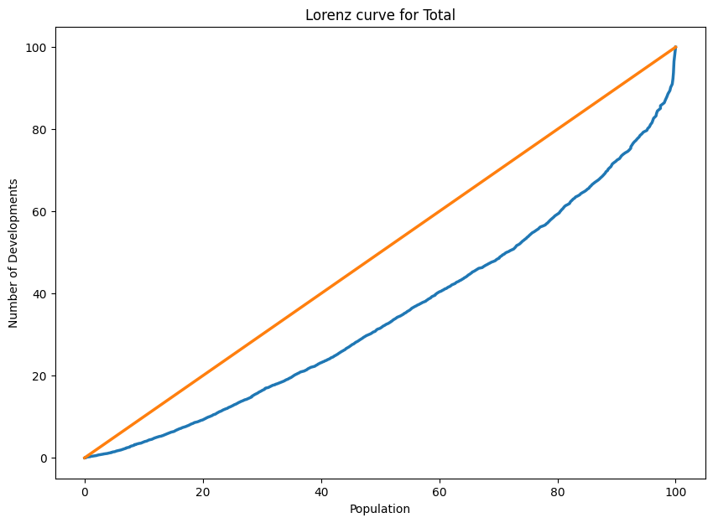
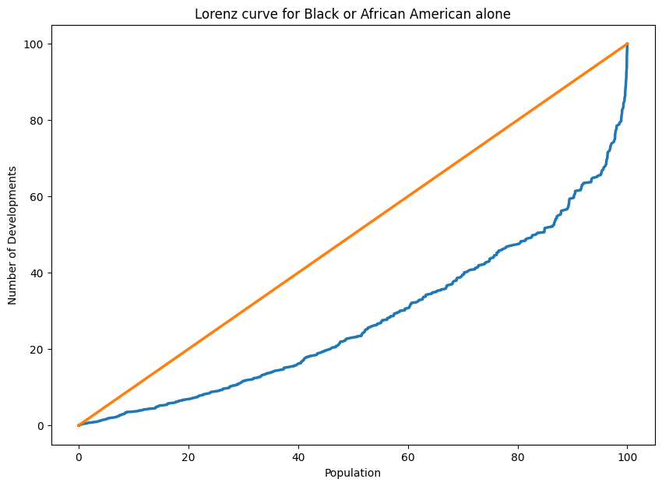
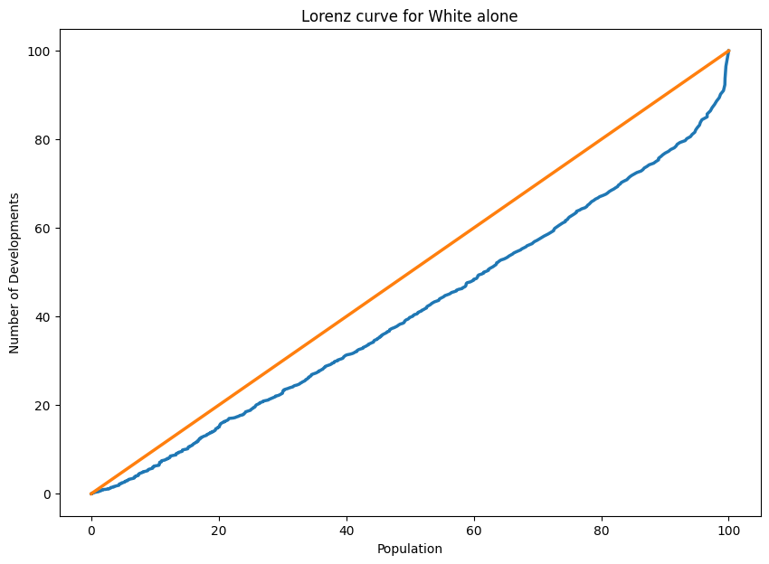
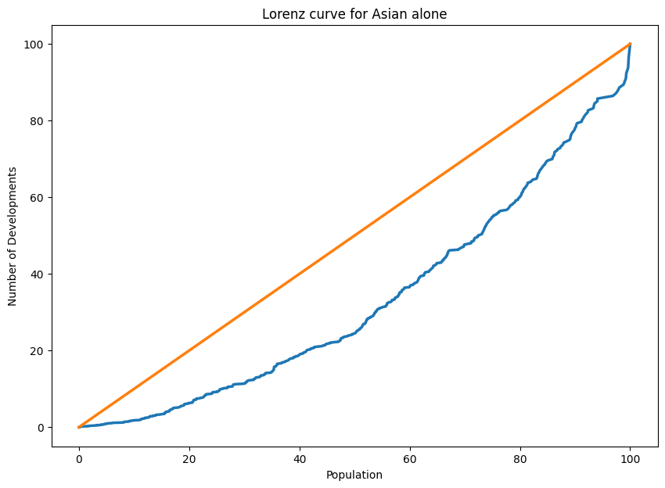
Demographic Lorenz Curves and Gini Coefficients
Gini Coefficients by census demographic group:
Total: 0.303
White alone: 0.181
Black or African American alone: 0.446
Asian alone: 0.335
Hispanic or Latino: 0.409
American Indian and Alaska Native alone: 0.409
Native Hawaiian and Other Pacific Islander alone: 0.455
Some Other Race alone: 0.392
Population of two or more races: 0.341

Slide 11


Extension Project
Questions
Datasets
Information
How did the pandemic outbreak affect the permitting process?
What factors can be predicted by machine learning to influence permit approvals?
Dataset of Massachusetts COVID-19 data including dates and confirmed case counts.
Combined dataset of approved and rejected permits.
Data visualization to compare trends in COVID-19 and permitting processes over time.
Implement a decision tree model to illustrate the factors influencing permit approvals and rejections.
Objective: Explore insights related to societal, political, and environmental factors.

Slide 12
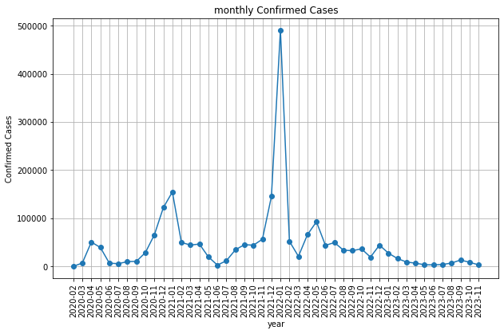
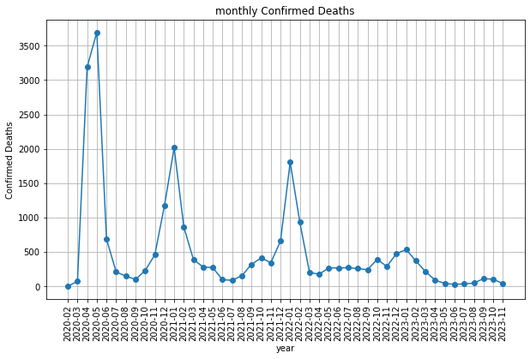
COVID19 .

Slide 13
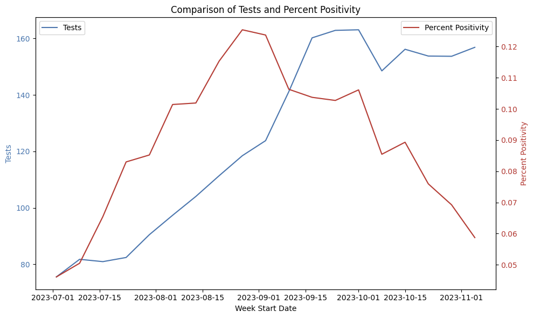
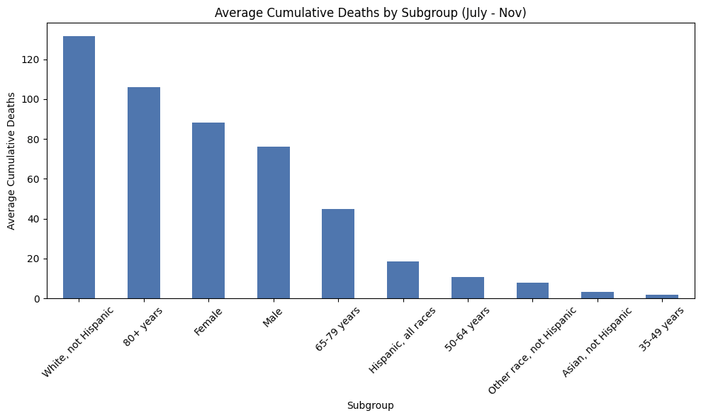
COVID19
Notes:
First graph: can see how increased tests as winter begins lowers the percent positivity
Second: Strange demographics having high cumulative deaths, different than expected

Slide 14
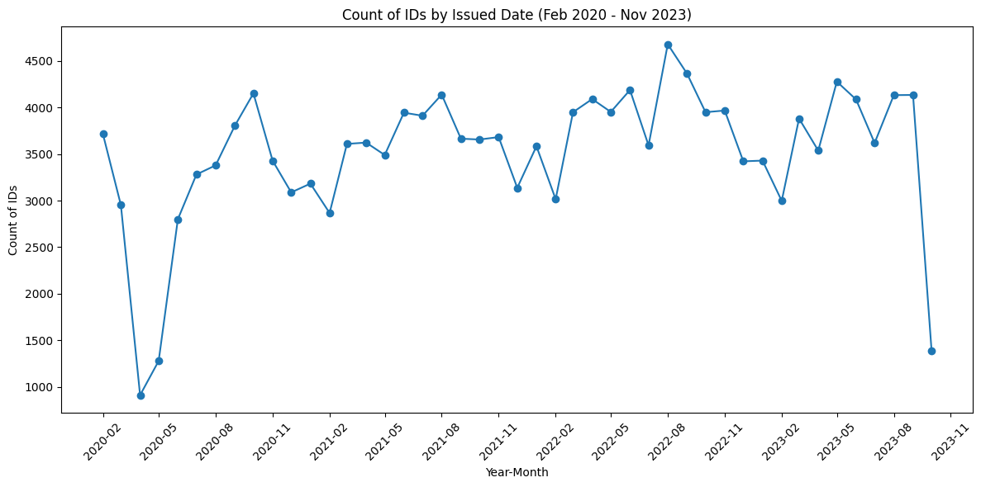
COVID19

Slide 15
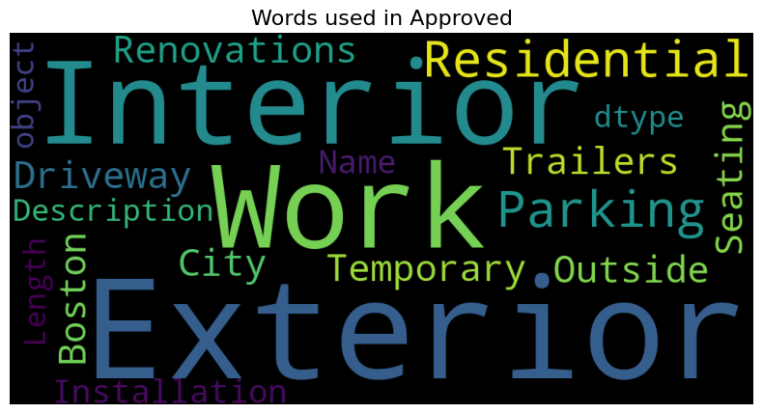
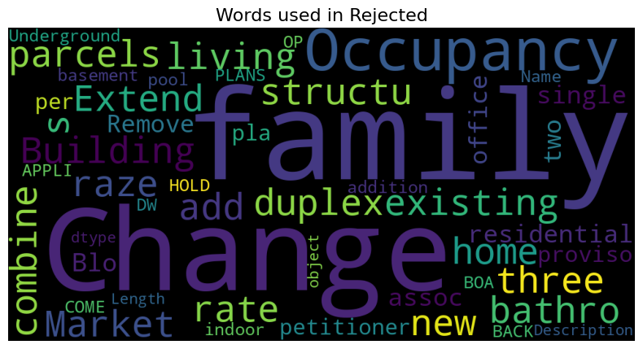
Prediction Features

Slide 16
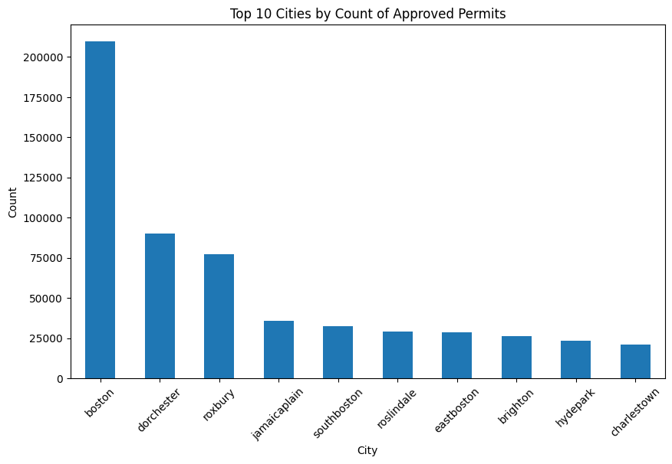
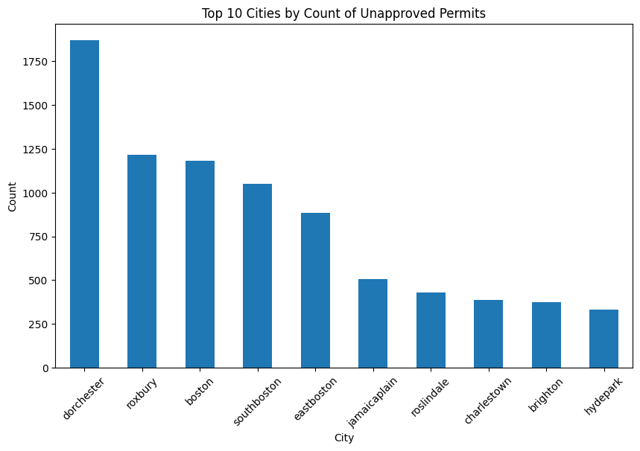
Prediction Features

Slide 17
Takeaways
Next Steps
Need for additional datasets for comparative analysis.
Emphasis on prioritizing relevant and valuable data to simplify the process.
Improved communication and effective work allocation is required for success.
Assumption: Location, work type, valuation, and size are key influencers in permit decisions.
Continue identifying patterns in environmental and political data, and conduct targeted in-depth analysis
Focus on narrative development using our data to craft a compelling final report.
In depth analysis of our extension project.

Slide 18
CITY of BOSTON
PERMITTING
Checkpoint A
CS 506 - Team D
David E. Kim (Team Lead)
Lukas Werk
Richard Hao
Efim Sokolov
Jackson Fisk

Slide 19
Boston Permitting Process
Rejected
Appeal
ZBA
Application
Apply and pay underlying fees for the permit
Plan Review & Zoning
City examines the plan for compliance with the zoning laws
Approved
Valid for six months

Slide 20
Datasets
Approved Permits
Approved Building Permits
Article 80 Permits
Approved Permits subject to Article 80
Zoning Board of Appeal
ZBA decisions
Census Data
For additional analysis

Slide 21
Goal
Analyze both the approved and rejected permits, including those assessed under Article 80, to uncover insights linked to broader societal, political, and environmental concerns.

Slide 22
Meetings
Current Progress
Division of Labor
Fridays 9 AM
Sundays 9:30 PM
Initial data cleaning
Initial visualizations
Preliminary Analyses
Census data merging
Geospatial visualizations
Project base questions answered
Exploratory Analyses
Extension project started
D.K. Project Lead and ZBA
R.H. Approved Permits
E.S. Census & Geospatial
J.F. Article 80 Permits
L.W. Data Prep. & Cleaning

Slide 23
Takeaways
Next Steps
Additional data and merging techniques are needed
Assumptions such as the impact of COVID-19 will need to be backed up by additional analysis
One or two more please
Continue finding environmental and political patterns and selectively investigating further
Improve our results by exploring different data subsets and cleaning optimizations
Work toward telling a story with our data and shaping our final report
Begin the initial stages of our extension project

